Slide 1
Online Shopping Mall
P2010411 Grant Jing
P2010556 Polo Liu
P2010562 Veronica Chen

Slide 2
Outline
} Business Model
Seller Center
Customer Q&A
Sidebar Shopping Cart
Shopping Festival
Coupons
}
User-friendly Design
}
Marketing

Slide 3
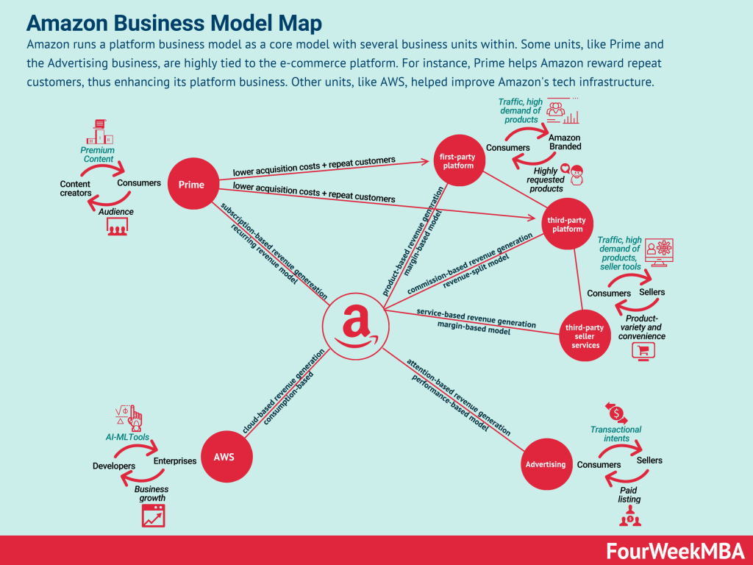
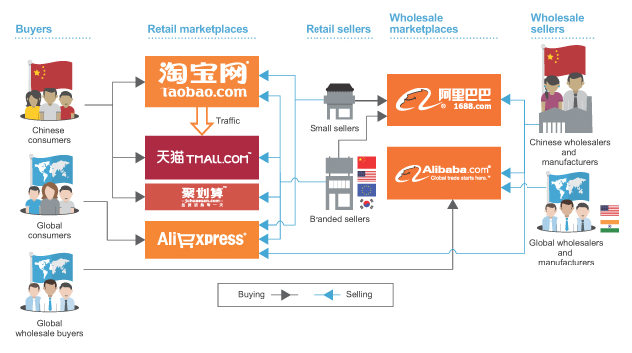
Business Model
Alibaba Business Model
B2B (Business to Customer)
+
C2C (Customer to Customer)
↓
Hybrid

Slide 4
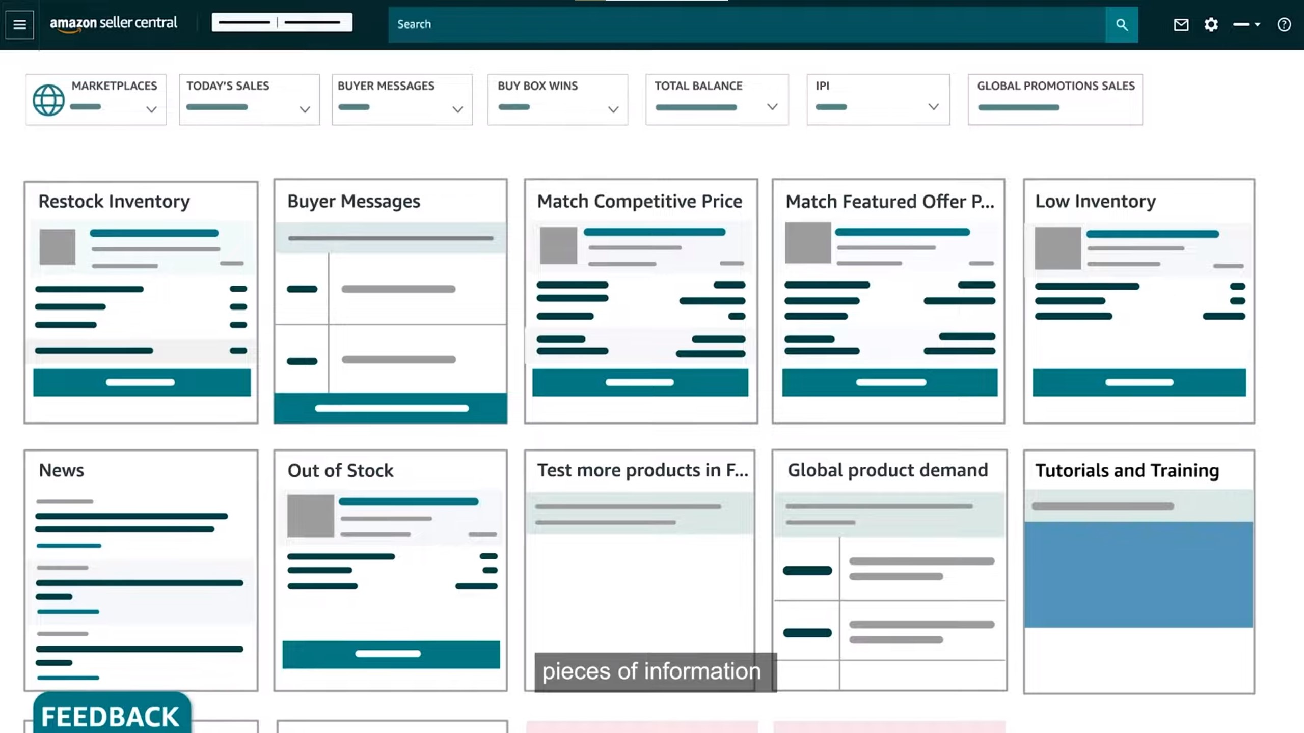
Seller Center
Provide a user-friendly interface especially for sellers in C2C business model
The Seller Center of Amazon

Slide 5


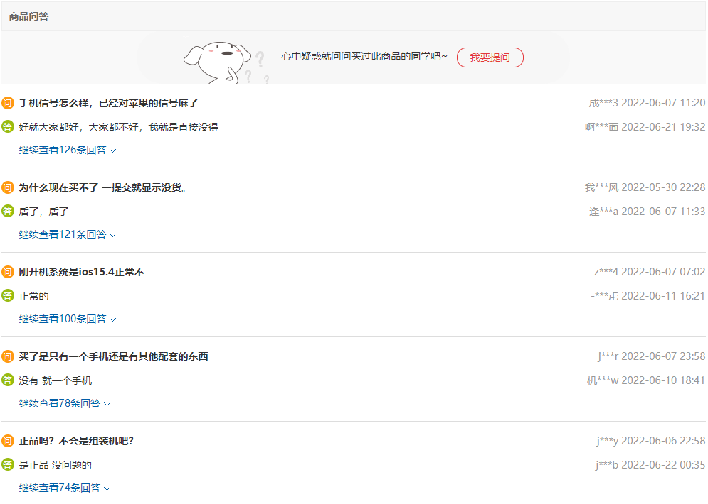
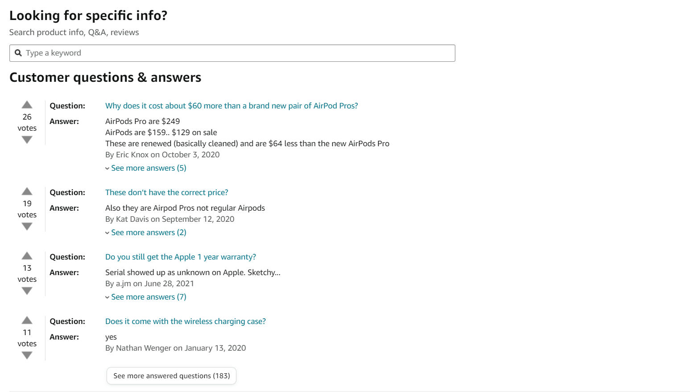
Customer Q&A Feature

Slide 6
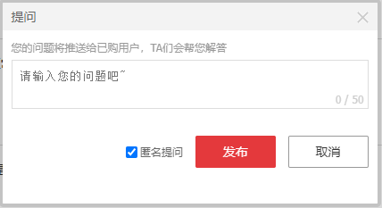
Customer Q&A Feature
This is the Customer Q&A from JD.com

Slide 7
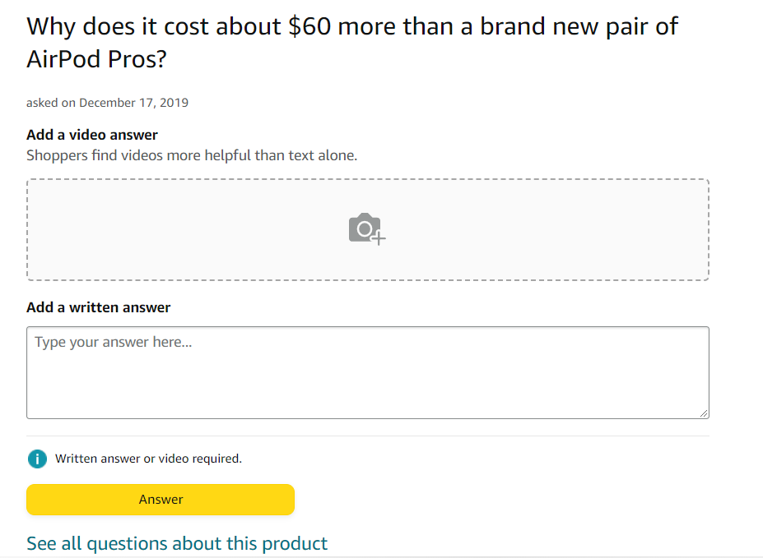
Customer Q&A Feature
This is the Customer Q&A from Amazon

Slide 8



Sidebar Shopping Cart

Slide 9
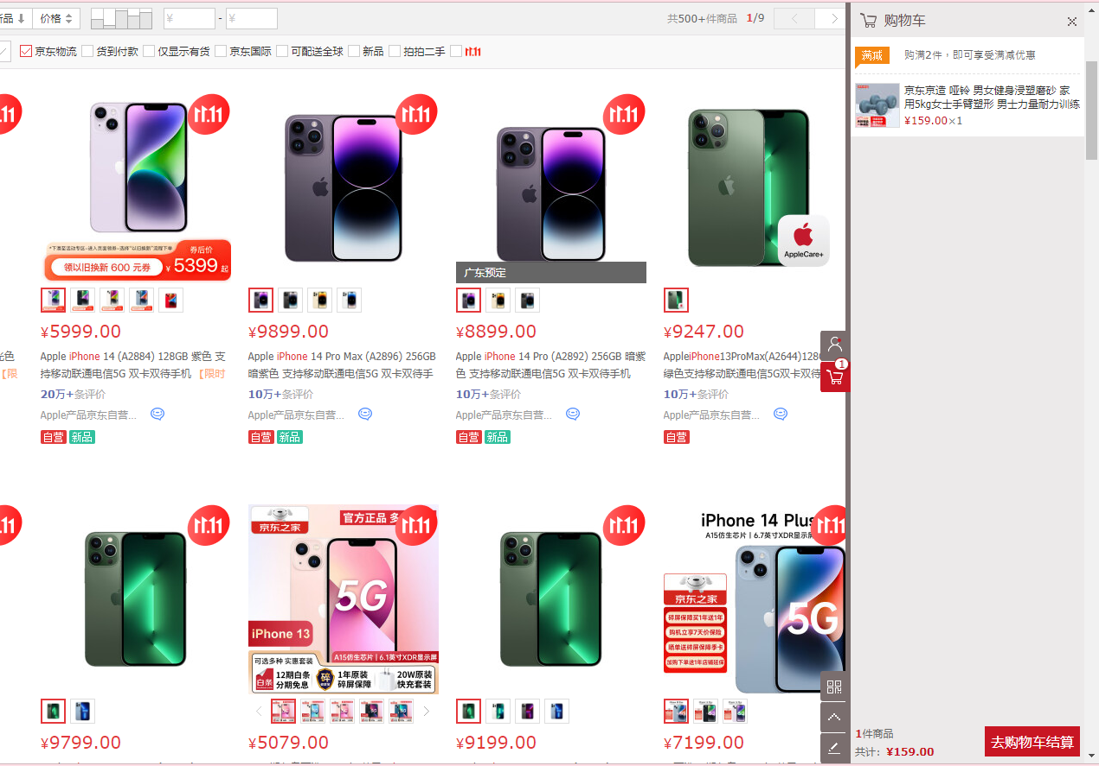
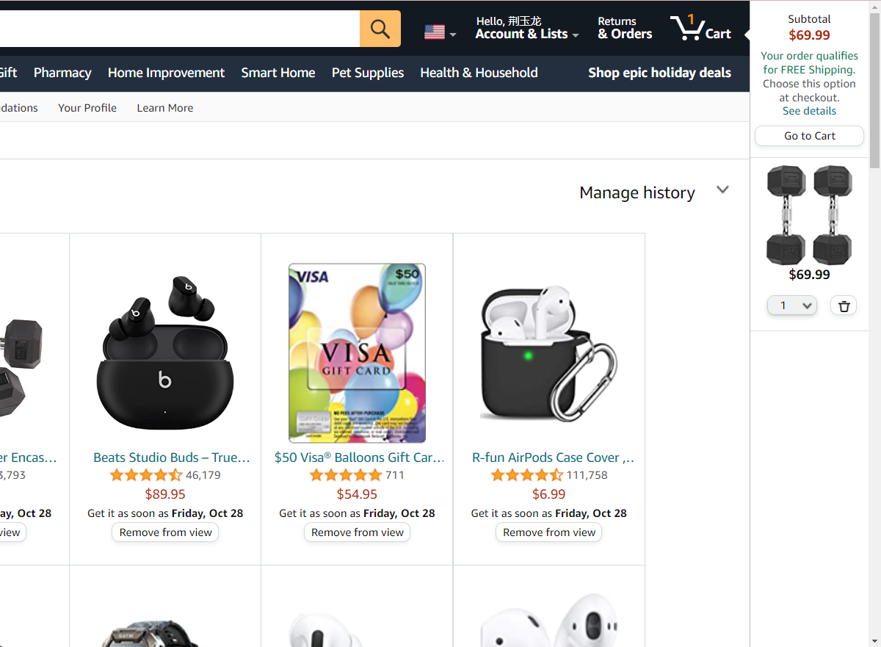
Sidebar Shopping Cart
The sidebar shopping cart of JD.com and Amazon

Slide 10
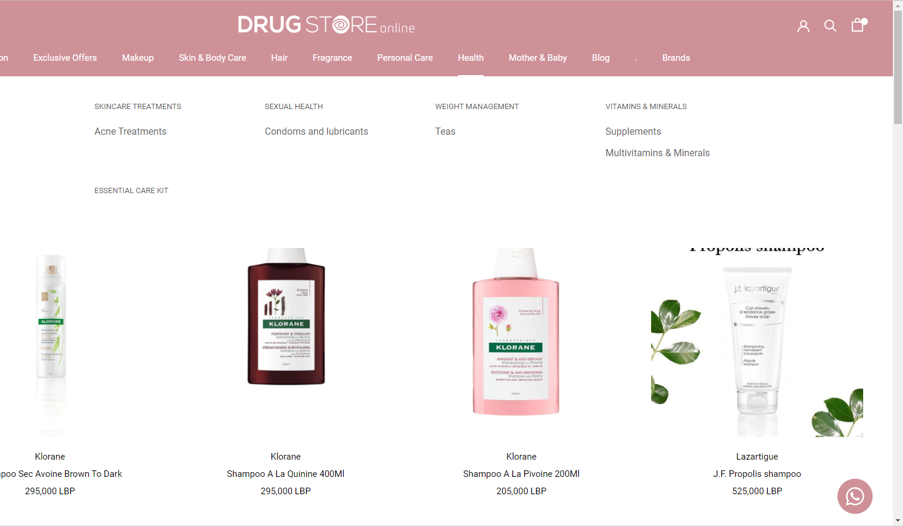
Sidebar Shopping Cart
This drug website doesn't have the sidebar shopping cart.

Slide 11


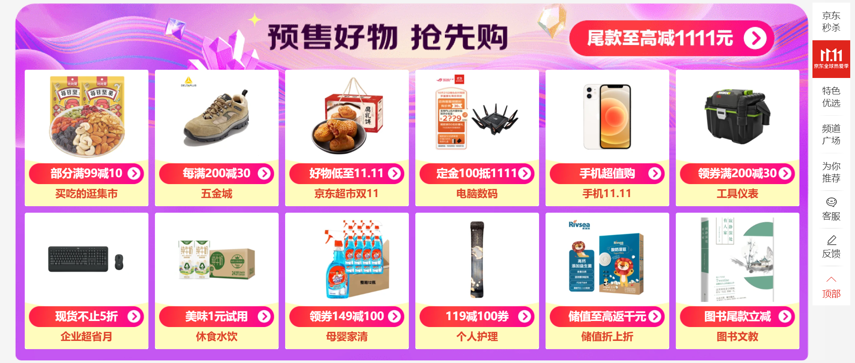
Marketing (Shopping Festivals)

Slide 12
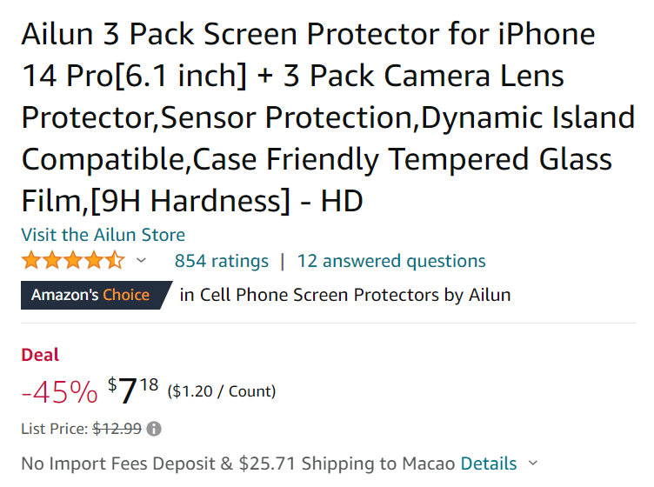

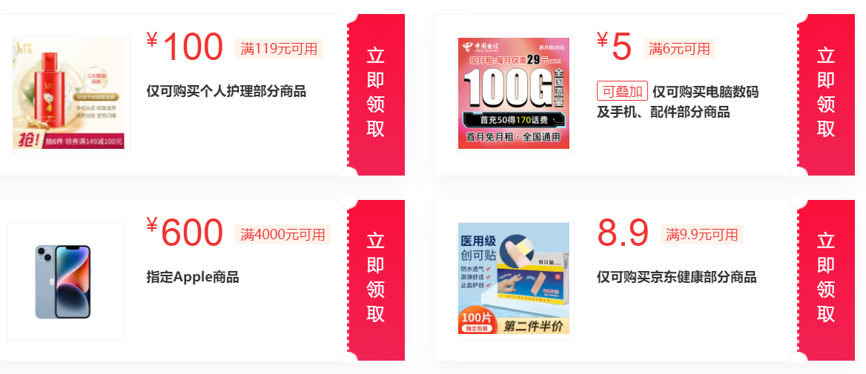
Marketing (Coupons)

Slide 13
Conclusion

Slide 14

Q & A

